Slide 1
Data Analysis of Commodity Prices
BY
Kapil Thakkar & Reshma Kumari
UNDER THE GUIDANCE OF
Dr. Aaditeshwar Seth

Slide 2
Objective
Supply demand imbalance, natural calamities etc. may not always be the reason behind the rise in the price of a commodity.
It may be a consequence of artificial supply deficit planned intelligently by traders’ nexus for profiteering through manipulation of supply of commodity and hence indirectly controlling their prices.
Our attempt is to locate such hikes in prices which seem suspicious (we call them anomalies).
To detect and analyse the characteristics of anomalies in the prices of commodities, currently only onion

Slide 3
Introduction
What is Anomaly?
Reasons for hike in the prices:
Supply Shortage
Government Policies
Hoarding
Political impact

Slide 4
Data we have
Structured Data (mostly 2006 onwards)
Daily Wholesale Price (WP) of Onion for 1514 Mandis
Daily Arrival of Onion information for 1514 Mandis
Daily Retail Price (RP) of Onion for 76 Centres (Major cities in India)
Unstructured Data
Dates and Location for hoarding reports from news articles

Slide 5
Method Used for Data Collection and Usage
Crawlers were written to fetch the prices (WP [1] & RP [2] ) and arrivals from 2006 onwards from government websites
Use of Voronoi Diagram to map Mandis to Centres
Average of WP of all Mandis in its region
Sum of Arrivals of all Mandis in its region

Slide 6
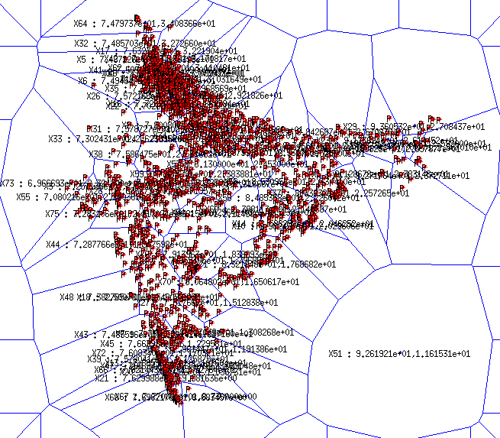
Voronoi Diagram

Slide 7
Assumptions
Retail price at centre is dependent on arrival and wholesale price of mandis in the region and has no effect from the other mandis not in region.
Mandis in the region of the centre don’t transact within themselves.
While calculating the wholesale price for a centre, distance between centre and mandi was not considered.
Smoothing of data was done over one week, for some of the methods
Modal wholesale prices are considered for calculations.

Slide 8
Characteristics of anomaly found from News Articles:
Large Difference between Retail and Wholesale Prices
Comparison of (Wholesale price, Arrivals) this year against last year at the same time period of year
Large Spike in the Retail Prices over duration of 2 weeks
All of the above parameters were calculated for every news article, some of the parameters deviated from the reported values. This may be because retail prices are reported for the lowest quality of commodity.

Slide 9
Approach - 1
Rise in arrival and wholesale price is computed wrt last year
If wholesale price rises despite increase in arrival, possible anomaly
Eg. In January 2009,at centre Mumbai, rise in arrival was reported to be 116.26% and rise in wholesale price was reported as 202.64% as compared to January 2008

Slide 10
Approach - 2
Calculate difference between Retail and wholesale price wrt wholesale price for every centre for everyday yearly.
Plot PDF/histogram for calculated values over year
Study type of distribution and its parameters
Find defaulter values based on distribution of values

Slide 11
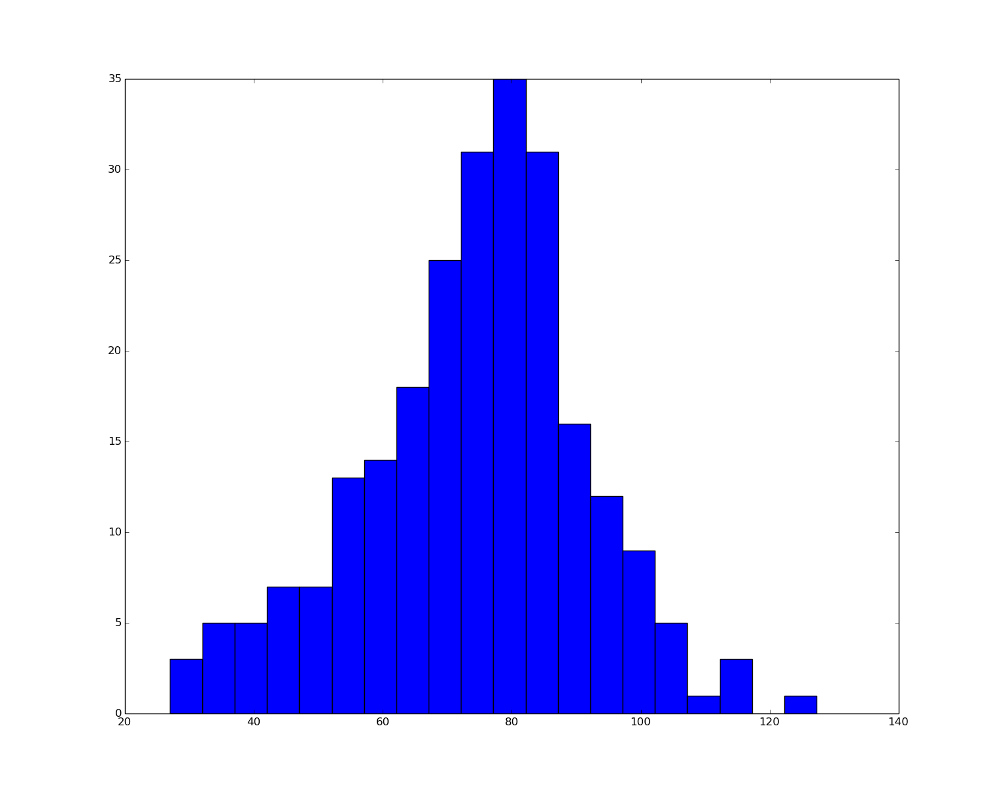
Approach - 2
Delhi - 2013

Slide 12
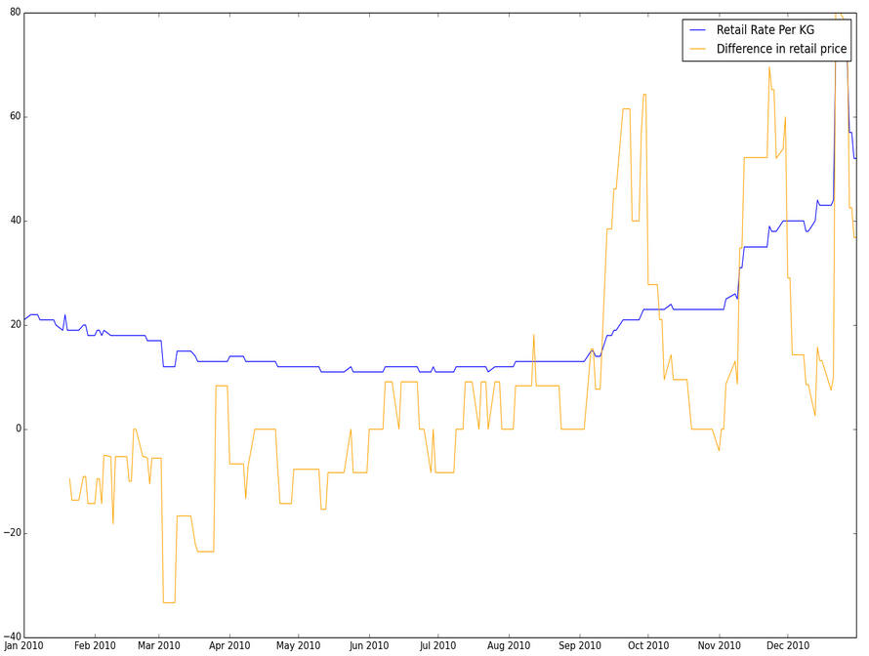
Approach - 3
Prepare series of values taking difference between retail prices over two weeks
Try to find the spike in this series
Report this period as anomaly
Centre: Mumbai
Year : 2010

Slide 13
Work done till now
Wholesale Price is inversely proportional to arrivals
Find the similarity between arrival pattern of this year and last year
To find similarity we have used lagged correlation with lag value of -15 to +14 days.
If arrival patterns are found similar, it is expected to have similar pattern for wholesale price
Locate the cases where wholesale price pattern varied despite having similar arrival patterns

Slide 14
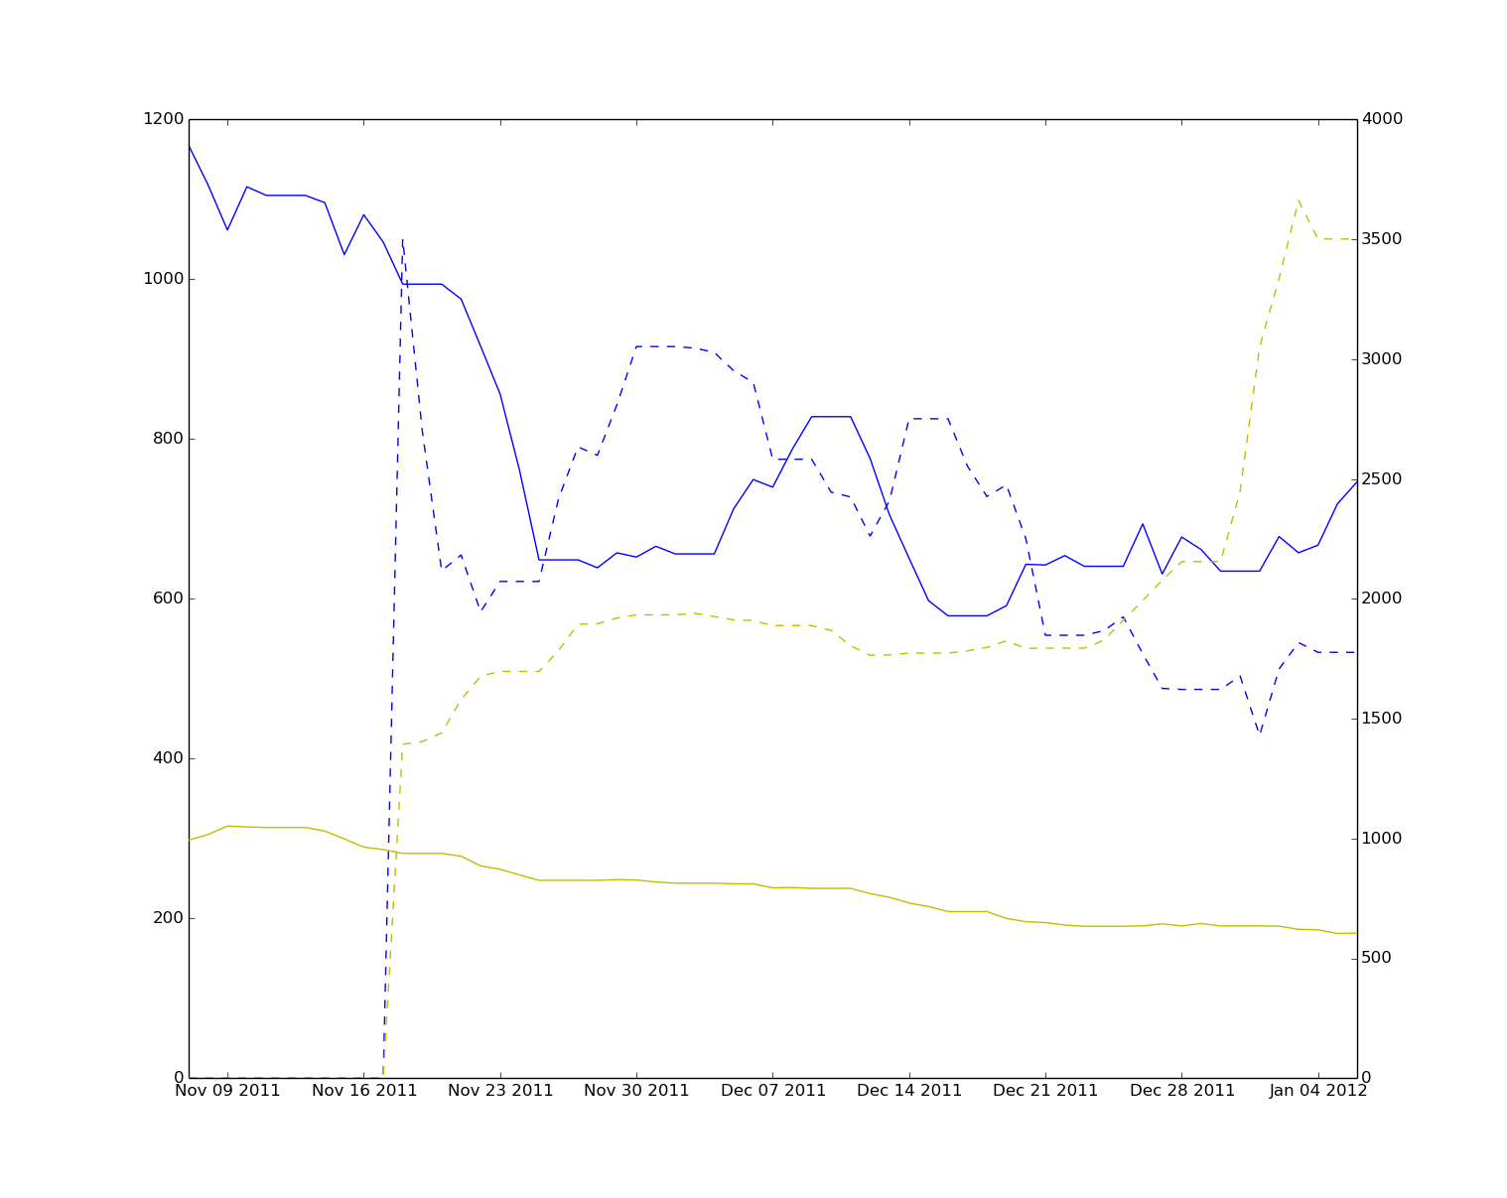


Example 1
Centre: Ahmedabad
Date: 07-11-2011 to
07-01-2012

Slide 15
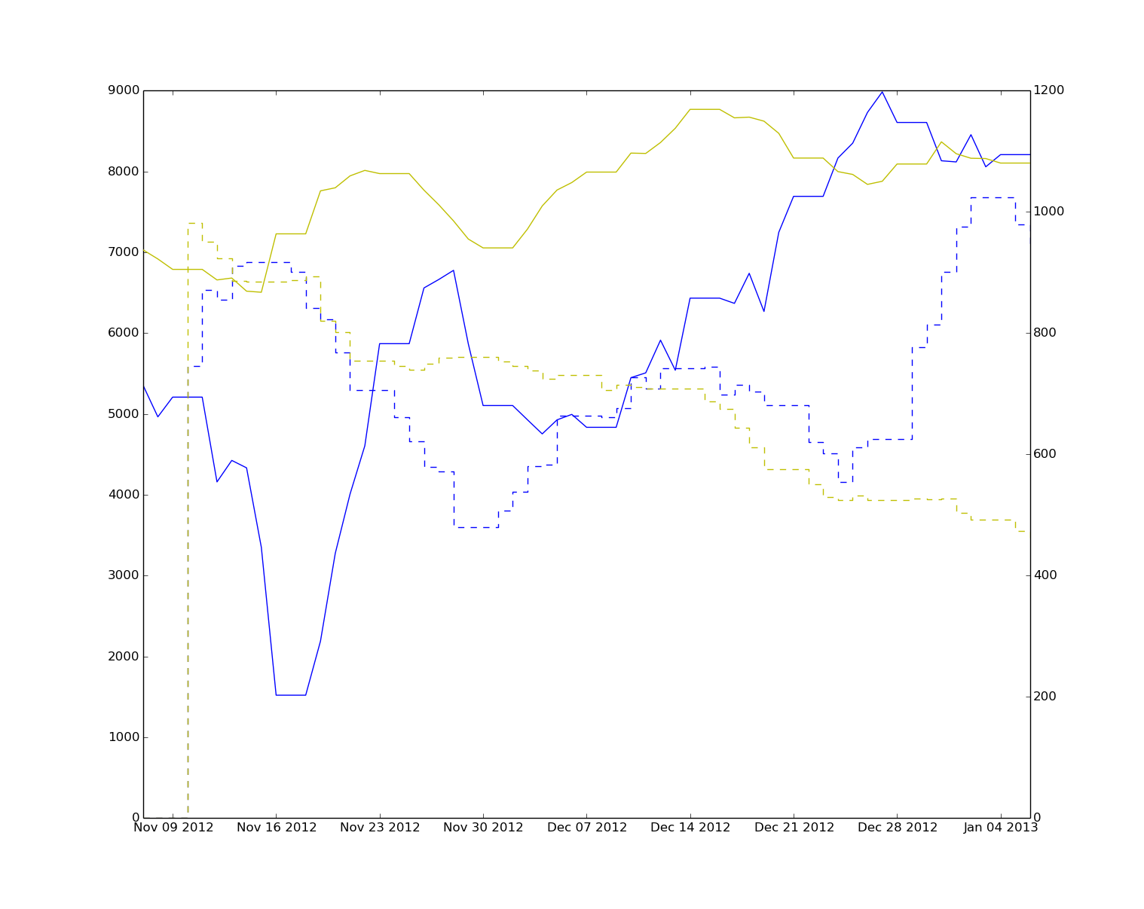
Example 2
Centre: Mumbai
Date: 07-11-2012 to
07-1-2013

Slide 16
Future Scope
To detect anti-competitive practices in setting up prices of commodities
To understand how external factors apart from supply demand like election influence prices of commodity

Slide 17
References
http://agmarknet.nic.in/agnew/NationalBEnglish/CommodityWiseDailyReport.aspx?ss=2
http://fcainfoweb.nic.in/PMSver2/Reports/Report_Menu_web.aspx

Slide 18
Thank You!!!
Any Questions?

